Slide 1
Contemporary Moral Problems
M-F12:00-1:00SAV 264
Instructor: Benjamin Hole
Office Hours: everyday after class
Email: bvhole@uw.edu

Slide 2
Agenda
Open Review
Clicker Quiz
Kant

Slide 3
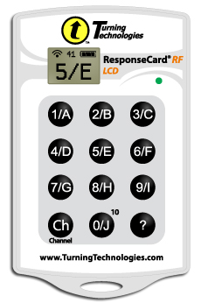
Please set your Turning Technology Clicker to channel 41
Press “Ch”, then “41”, then “Ch”

Slide 4
In Kant’s terminology, a maxim is:
a principle on which one acts.
a moral duty.
an action that brings about more good than any other available action.
a bit of folk wisdom.
all of the above.
none of the above.

Slide 5
Kant refers to a will that is determined by things outside of itself as:
compelled.
heteronomous.
contradictory.
debased.
all of the above.
none of the above.

Slide 6
Kant does not formulate his fundamental Law of morality, the categorical imperative, in terms of:
natural law
universal law
humanity as an end in itself
the kingdom of ends
all of the above.
none of the above.

Slide 7
The Good Will
Kantian Ethics

Slide 8
Explicating the good will:
Kant’s Three Propositions
“to have moral worth an action must be done from duty”
“An action performed from duty does not have its moral worth in the purpose which is to be achieved through it but in the maxim by which it is determined.”
“Duty is the necessity of an action executed from respect for the law.”

Slide 9
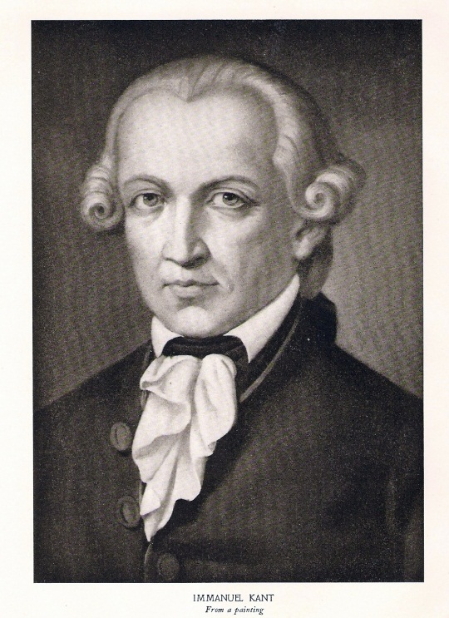
Moral Value
Maxim: “principle of volition” or reason for action.
Hypothetical Imperatives claim that a possible action is necessary as a means to the attainment of something one wants.
A Categorical Imperative represents an action as objectively necessary, without regard to a further end.

Slide 10
Comparison
Utilitarianism
Kantianism
Theory of value: pleasure is the only intrinsic good.
Right action: consequences are the sole determinate.
Motivation: the agent’s maxim is irrelevant to the action’s moral worth.
Theory of value: the good will is the only unconditional good.
Right action: consequences are irrelevant.
Motivation: the agent’s maxim is the sole determinant of moral worth.

Slide 11
The Universal Law Formulation of the Categorical Imperative
Kantian Ethics

Slide 12
CI: The Formula of Universal Law
“Act only according to that maxim by which you can at the same time will that it should become a universal law of nature.”
“An action is right if and only if one can (a) consistently conceive of everyone adopting and acting on the general policy of one’s action, and also (b) consistently will that everyone act on that maxim” (Timmons, 17).

Slide 13
CI: The Formula of Universal Law
Take a maxim
Universalize it
Run your consistency test(s)
Contradiction in conception?
Contradiction in rational will?

Slide 14
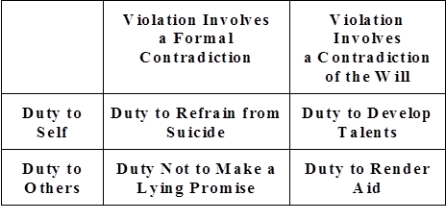
Kant’s Four Examples

Slide 15
Kinds of duties
Perfect Duties
Imperfect Duties
“A perfect duty is one that strictly requires certain specific actions, with no choice or leeway” (B/B, 358).
Determined by the contradiction in conception test.
E.g., The lying promise
“an imperfect duty is one that can be fulfilled in several different ways, among which the agent may choose, and thus no one of which is strictly required” (B/B, 358).
Determined by the contradiction in will test.
E.g., The duty to render mutual aid.

Slide 16
Kant’s Argument
You should only do those actions that conform to rules that you could will to be adopted universally.
If you were to make an insincere promise, you would be following the rule: when I believe myself to be in need of money, I shall borrow money and promise to repay it, even though I have no intention of repaying it.
This rule could not be adopted universally, because it would be self-contradicting.
Therefore, you ought not to make lying promises.

Slide 17
Kant’s Argument
You should only do those actions that conform to rules that you could will to be adopted universally.
If you were to refuse to aid others in need, you would be following the rule: when I believe others to be in need I will not aid them.
This rule could not be willed universally, because it would defeat the rational will’s wider purposes. (A universal law would imply that others never help you when you are in need.)
Therefore, you should accept the (imperfect) duty to aid others in need.

Slide 18
Objections
Kant’s Universal Law Formulation of the Categorical Imperative

Slide 19

Rigorism
Problem: You have Nazi’s at your door asking, “Do you know where any Jews are?”
Does Kant give us the right answer?

Slide 20
The rigorism objection.
Strongly Agree
Agree
Somewhat Agree
Neutral
Somewhat Disagree
Disagree
Strongly Disagree

Slide 21

What’s the maxim?
The Sneaky Maxim Maker Objection
MacIntyre: “the Categorical Imperative imposes restrictions only on those insufficiently equipped with ingenuity”
(A Short History of Ethics, 198).
Is universalizability vacuous and conservative?

Slide 22
The Sneaky Maxim Maker Objection
Strongly Agree
Agree
Somewhat Agree
Neutral
Somewhat Disagree
Disagree
Strongly Disagree

Slide 23

Mill’s Criticism
“[Kant] fails, almost grotesquely, to show that there would be any contradiction, any logical (not to say physical) impossibility in the adoption by all rational beings of the most outrageously immoral rules of conduct … All he shows is that the consequences of their universal adoption would be such as no one would choose to incur”
(JS MILL, Utilitarianism).
Is Kant guilty of covert consequentialism?

Slide 24
The Covert Consequentialism Objection
Strongly Agree
Agree
Somewhat Agree
Neutral
Somewhat Disagree
Disagree
Strongly Disagree

Slide 25
The Universal Law Formulation of the CI: “Act only according to that maxim by which you can at the same time will that it should become a universal law of nature.”
Strongly Agree
Agree
Somewhat Agree
Neutral
Somewhat Disagree
Disagree
Strongly Disagree

Slide 26
The Humanity Formulation
Kant’s Categorical Imperative

Slide 27
Humanity Formulation
“Act so that you treat humanity, whether in your own person or in that of another, always as an end and never as a means only.”
Negative Aspect: “never as a mere means”
Positive Aspect: “always as an ends”

Slide 28
The Humanity formulation of Kant’s categorical imperative
Strongly Agree
Agree
Somewhat Agree
Neutral
Somewhat Disagree
Disagree
Strongly Disagree

